Slide 1
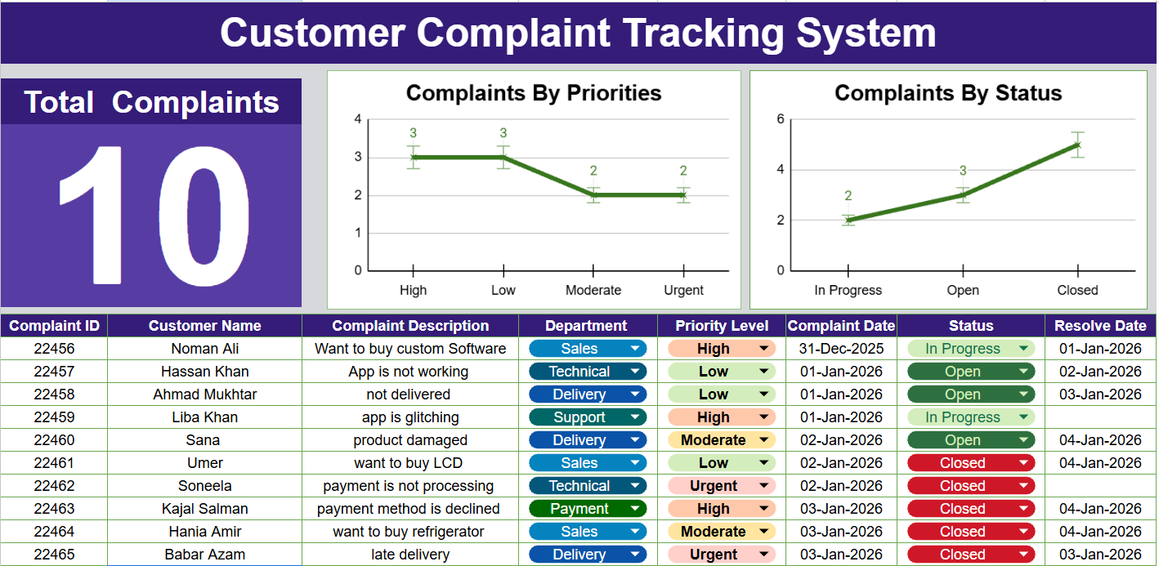
Customer Complaint Tracking System
(Powered By AICT)
Department of Mechatronics & Control Engineering

Slide 2
Table of Contents
01
02
03
04
Introduction
Scope & purpose
of system
Problem Defination
Limitations of Manual Complaint Handling
System Analysis
Improve Customer Satisfaction
Objectives
User & Function
Requirements
Results
05
Researchs

Slide 3
Introduction
Designed To Record, Manage and Resolve Customer Complaints
CCTS Provide A structured Way to Track Complaints
It Ensures Timely Responses
CCTS Improve Customer Satisfaction and Overall Organizational Efficiency

Slide 4
Table of Contents
01
02
03
04
Introduction
Scope & purpose
of system
Problem Defination
Limitations of Manual Complaint Handling
System Analysis
Improve Customer Satisfaction
Objectives
User & Function
Requirements
Results
05
Researchs

Slide 5
1
Delayed Response
4
Key Problems
(Before AICT)
Misplace
Records
2
Communication Gaps
5
No Progress Details
3
Customer Dissatisfaction

Slide 6
Table of Contents
01
02
03
04
Introduction
Scope & purpose
of system
Problem Defination
Limitations of Manual Complaint Handling
System Analysis
Improve Customer Satisfaction
Objectives
User & Function
Requirements
Results
05
Researchs

Slide 7
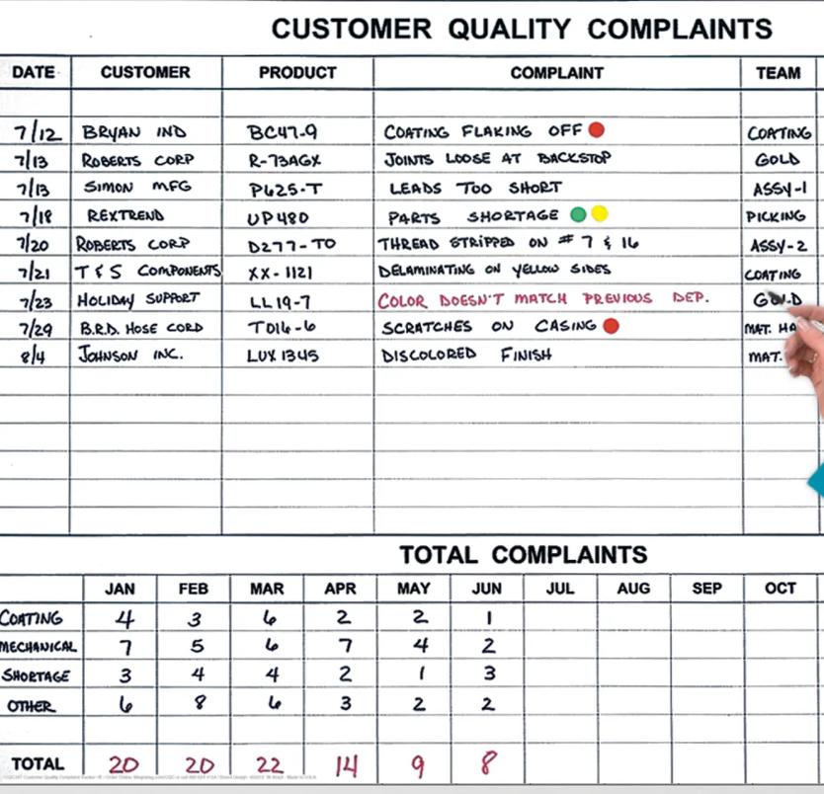
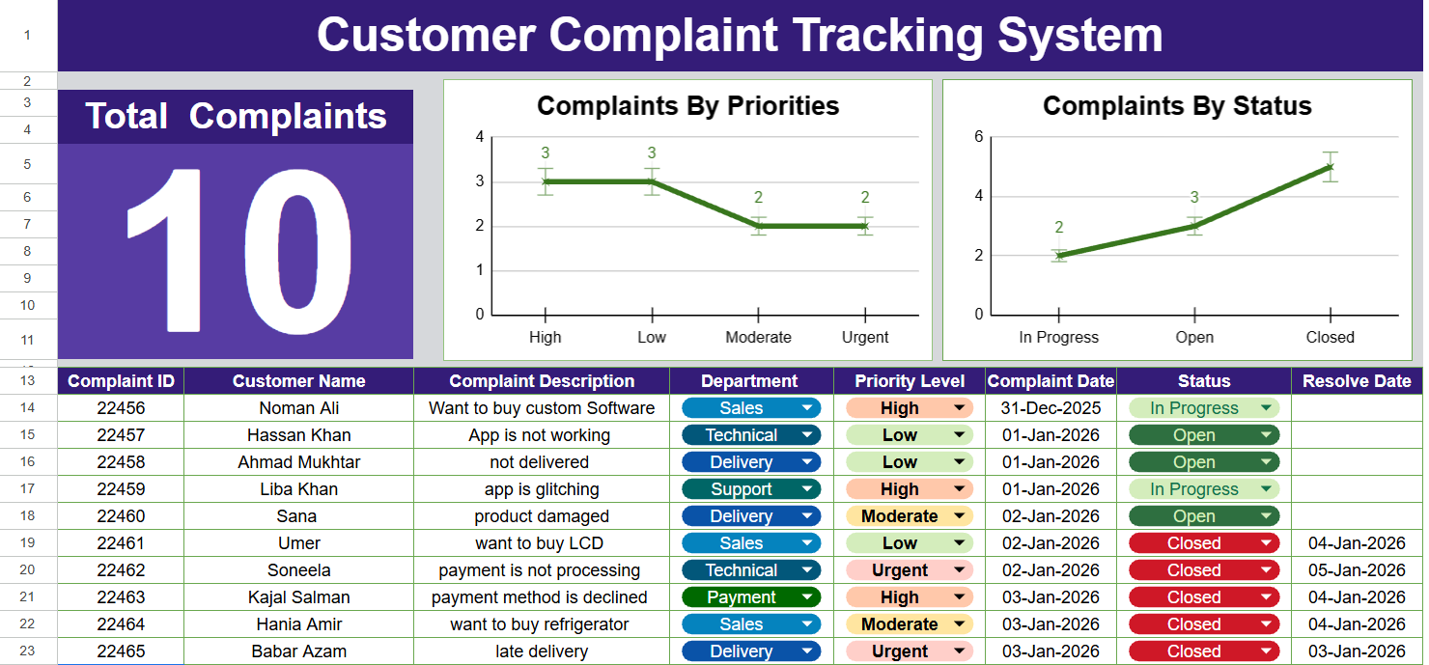
Before
After

Slide 8
01
User register his complaints to
the System
Complaint Tracking
system
02
System receive complaints and inform the respective department
03
Department take action on it and Resolved the complaint
04
The user sends feedback to the server as he satisfied or not with solution

Slide 10
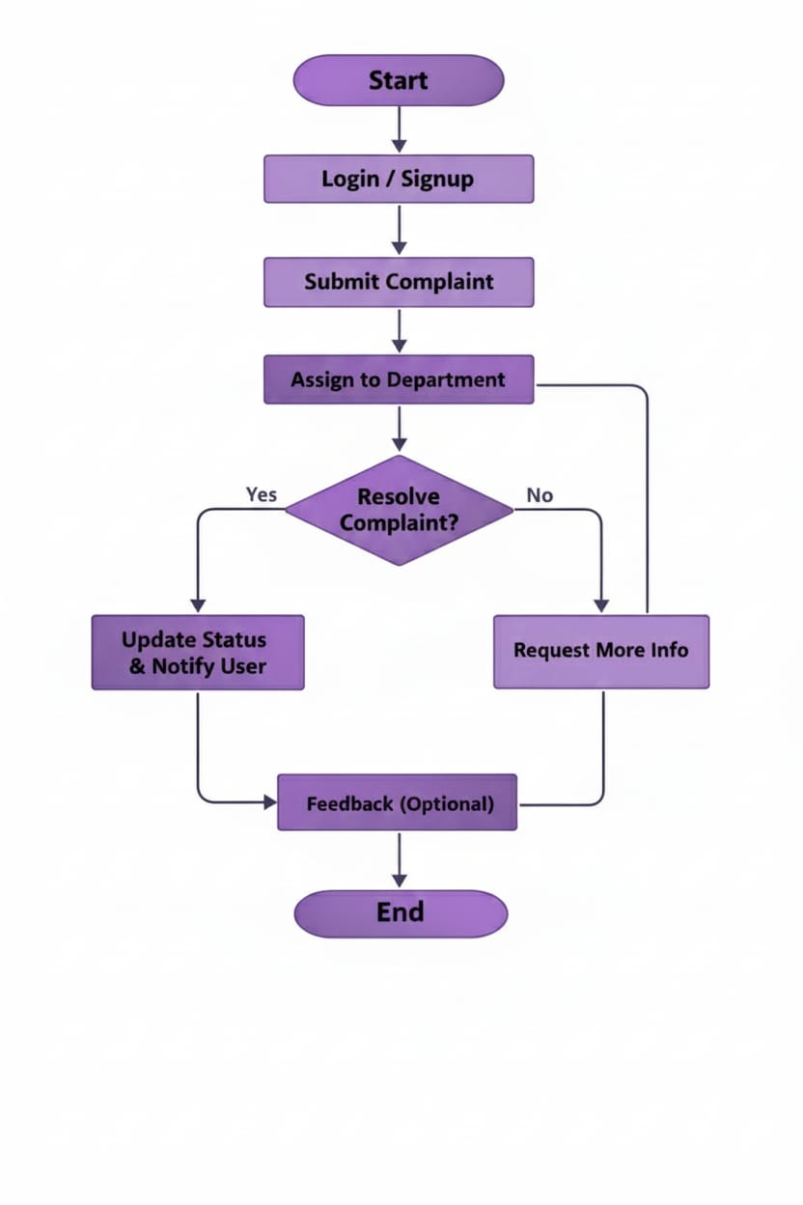
03
04
02
05
01
06

Slide 11
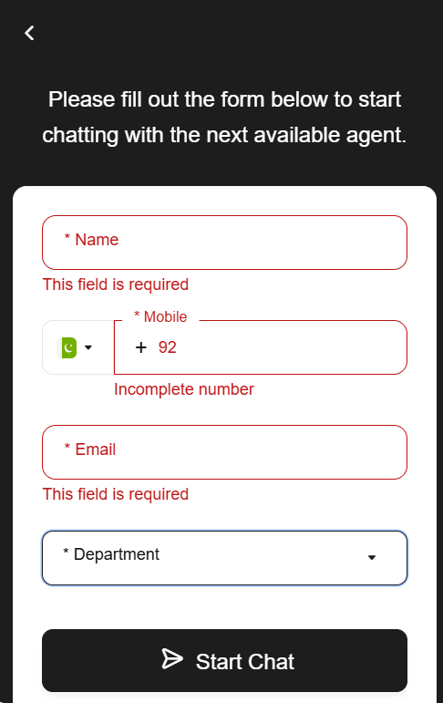
How it Works?

Slide 12
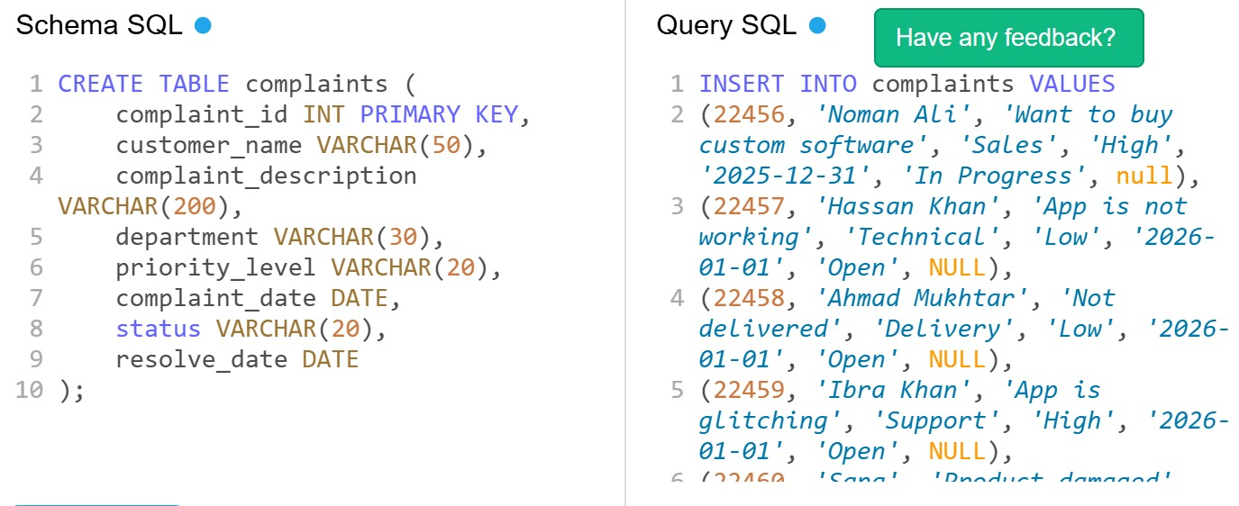
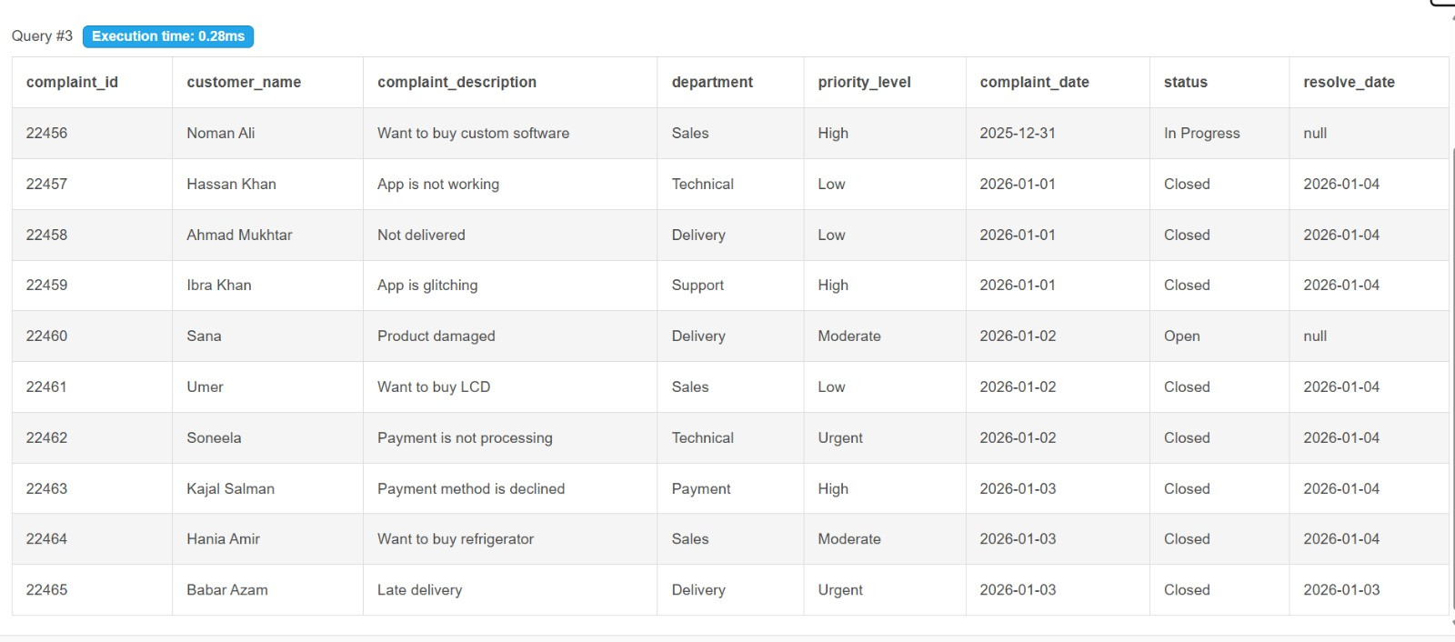
How it Works?
“All the records that we add in google sheet will also be added in Data Base Management System (SQL)”

Slide 13
Table of Contents
01
02
03
04
Introduction
Scope & purpose
of system
Problem Defination
Limitations of Manual Complaint Handling
System Analysis
Improve Customer Satisfaction
Objectives
User & Function
Requirements
Results
05
Research's

Slide 14
Objective Of Complaint Tracking System
Fast Response
Fast in Taking Action
Customer Satisfaction
Progress Tracking
Less Labour Cost
Reduce cost
Data Analysis
Efficiency
Stores information about complaints
Highly Efficient

Slide 15
Table of Contents
01
02
03
04
Introduction
Scope & purpose
of system
Problem Defination
Limitations of Manual Complaint Handling
System Analysis
Improve Customer Satisfaction
Objectives
User & Function
Requirements
Results
05
Research's

Slide 16
Less than half (41%) of the complainants felt they were treated fairly during the process.
Even fewer (39%) were satisfied with how their complaint was ultimately handled.
The data suggests a significant majority of people are dissatisfied with current complaint resolution processes.
Source: Orla Deasy

Slide 17
Duration for complaint resolution (Before AICT)
5 or less Business Days
More Then 40 Days
34%
14%
6 to 40 Business Days
48%
Source: Qhsealert.com

Slide 18

Duration for complaint resolution (After AICT)
Drop in Resolution Time
45%
(Over All)
Source: Qhsealert.com

Slide 19

Conclusion
Our Customer Complaint Tracking System ensures faster resolution, improved transparency, and higher customer satisfaction. By organizing and analyzing complaints efficiently, businesses can continuously improve their services and build stronger customer trust.

Slide 20



